Slide 1
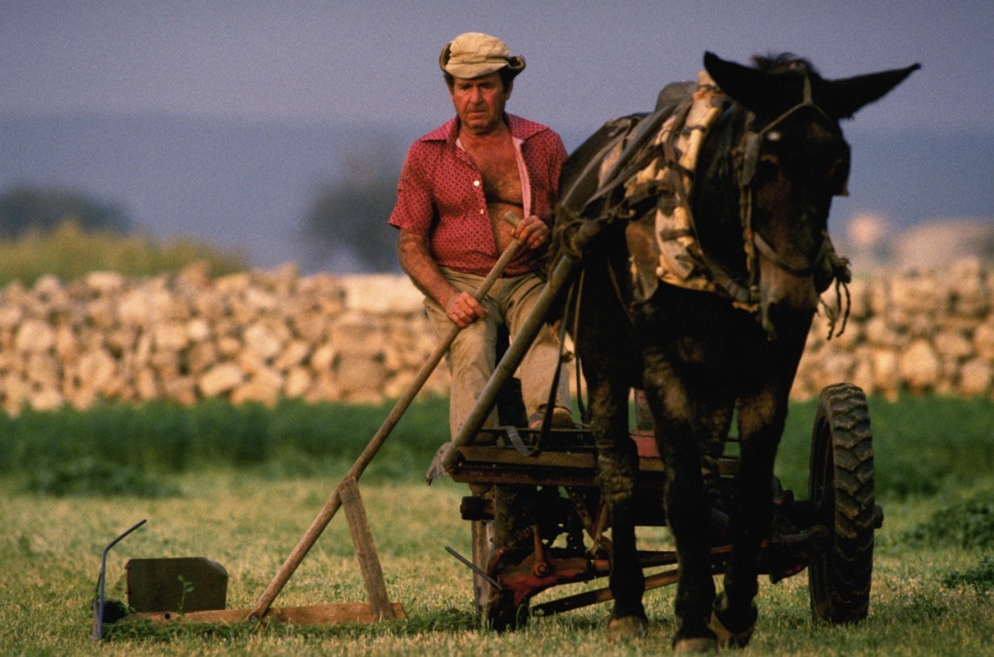
Work outside

Slide 2
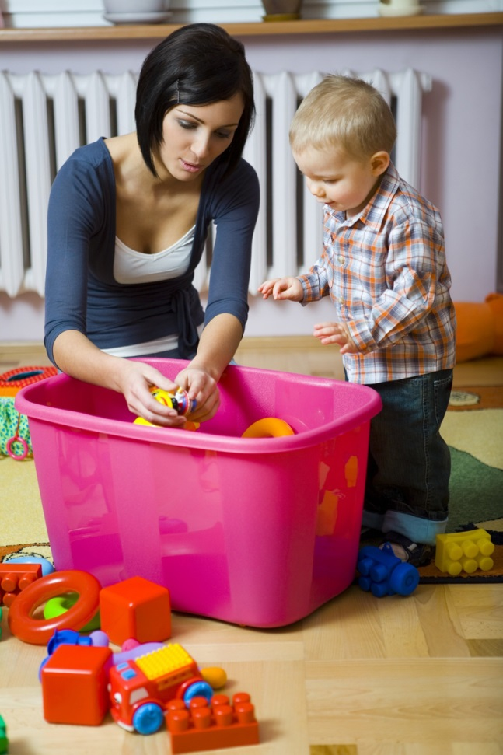
Work inside

Slide 3
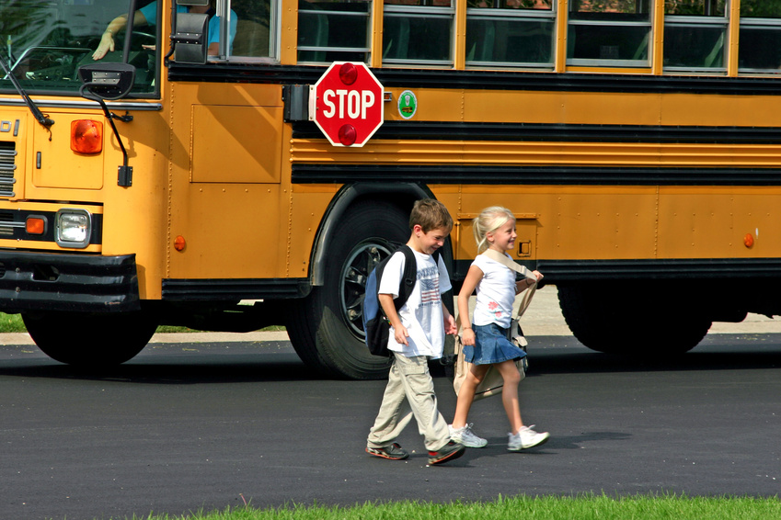
work with children

Slide 4
work with food

Slide 5
fix things

Slide 6
work with money

Slide 7
clean

Slide 8
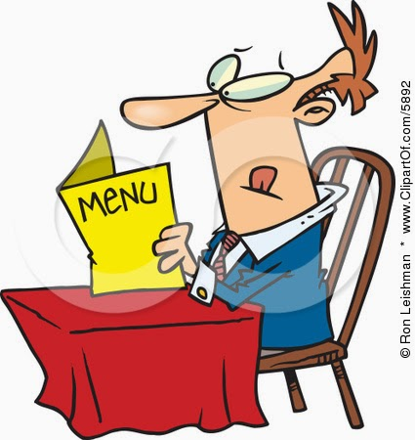
work in a restaurant

Slide 9
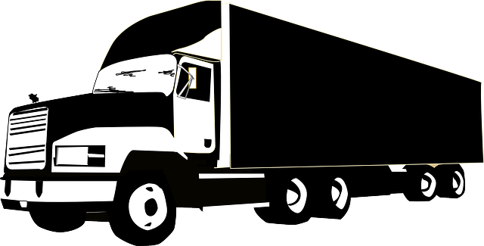

drive a vehicle

