Slide 1

Onboarding Your ABE Staff: The Best Investment for your Program.

Slide 2
About Us
Beginning
Intermediate
Advanced
ESL
Classes
Reading/Writing.
Burlington English.
Digital Literacy
Project Success 2 and 3.
Citizenship
Project Success 4
Advanced / Writing. TOEFL. Digital Literacy.
Notes:
ESL Classes (Life Skills):
Beginning
Intermediate
Advanced I and II
TOEFL (Test of English as a Foreign Language)
ESL Blended Learning
Computer Basics
IELCE/Citizenship
Volunteer Tutoring and Labs (Conversation and Writing)

Slide 3
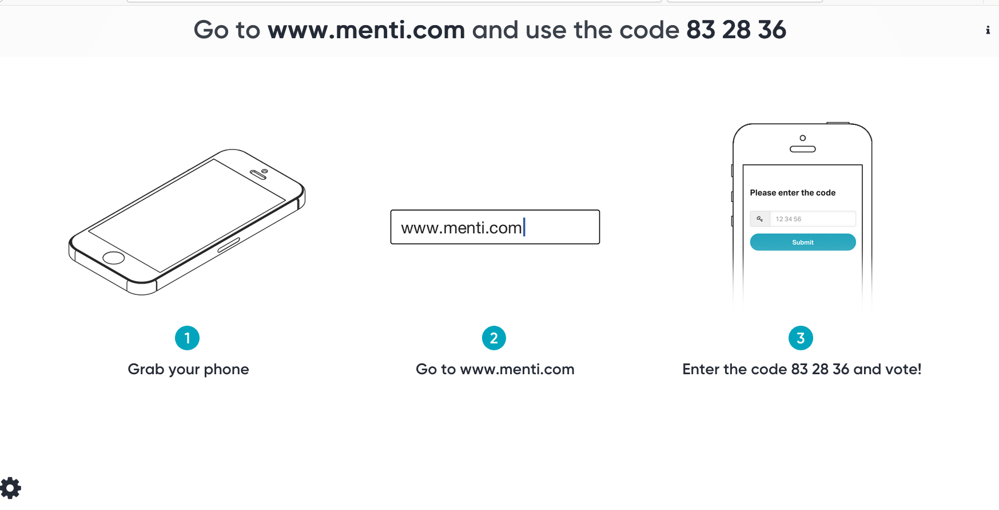
About You

Slide 4
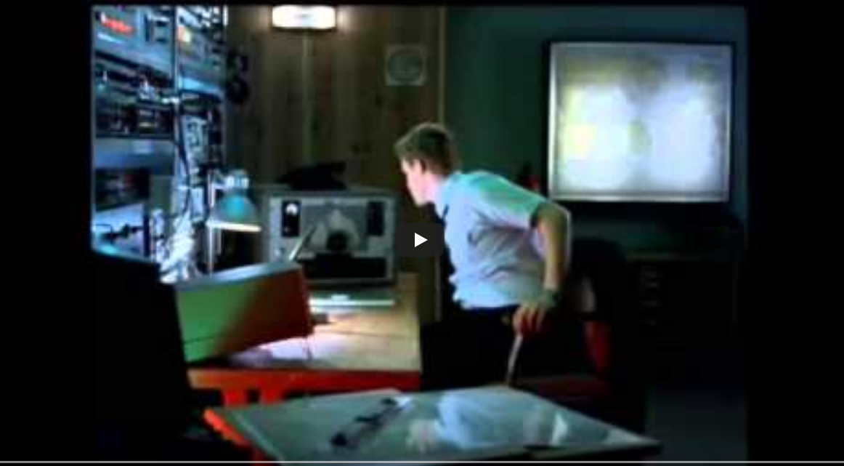
Onboarding Your ABE Staff: The Best Investment for your Program.
A comprehensive approach to hiring, training, and investing in your teachers.
First Day at Work

Slide 5
Think and Discuss
Think about how you were onboarded for your current role.
Discuss with 1-2 people next to you.

Slide 6

Benefits of a comprehensive approach.
Notes:
Reduce Stress
Improved Job performance
Employee Satisfaction
Better retention

Slide 7
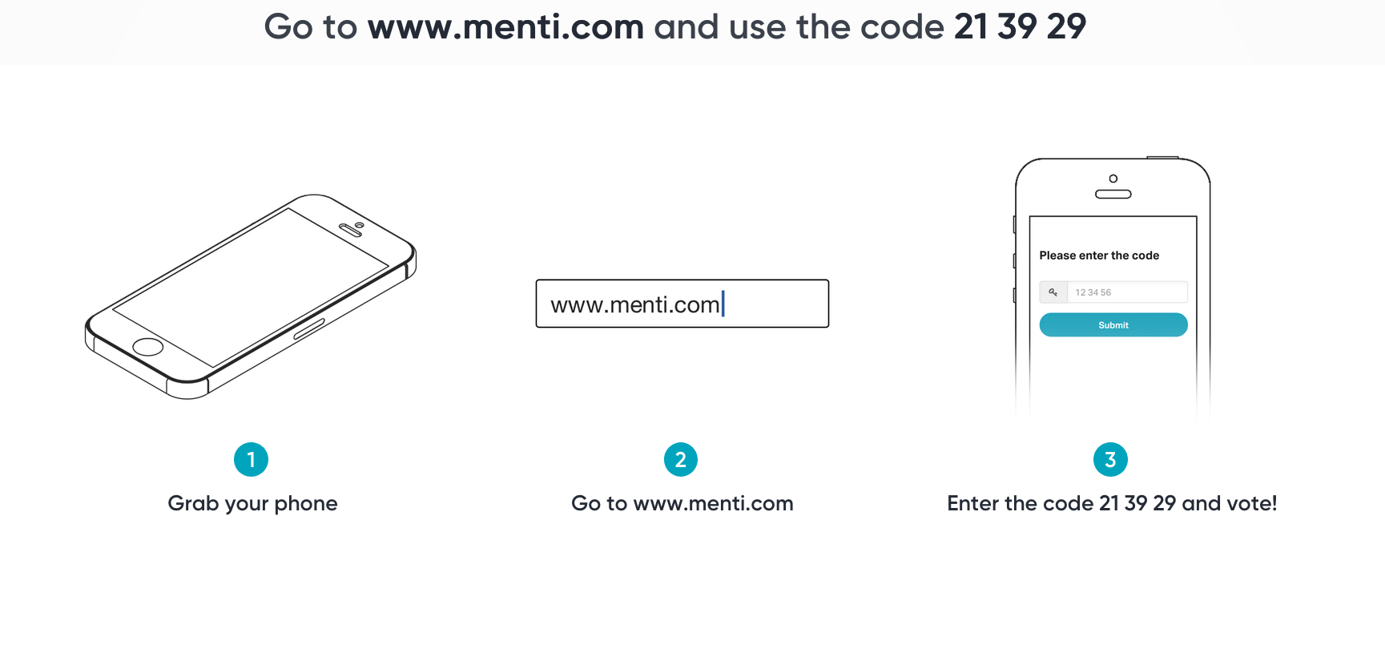
Notes:
Our experience is mainly with part-time Teachers, and Subs but we hope you can see that this is transferrable.
Stay on menti for a bit

Slide 8

An Approach for your ABE program
Hiring
New Hire Training
Professional Development

Slide 9

Knowing What We Want
Setting Up for Success
Minimum Qualifications
Resume & Cover Letter
Experience
Passion
Interview Process
15 Min. Demo
Questions
Selection
Notes:
Knowing What We Want
Setting Ourselves Up for Success
The Entryway - Minimum Qualifications
Resume and Cover Letters
Experience and passion
Interview Process
Show Us You Can Teach Adult ESL Students – the Ten-minute Teaching Demonstration
Questions-have them standardized. We use a standardized set of questions, along with instructions, so that anyone can fill in for us if something comes up (and none of us is able to be present)
Selection of Candidates

Slide 10
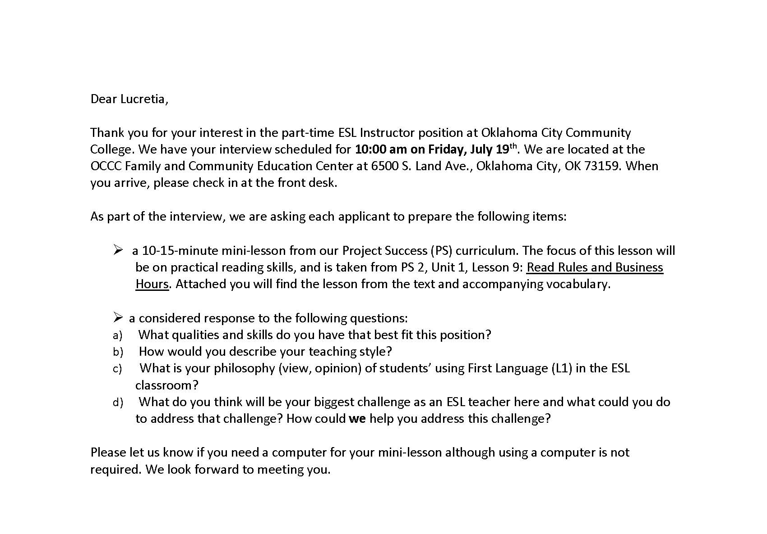
Hiring: The Invitation
Choose a qualified applicant
Contact Candidate
Official Interview Invitation Email

Slide 11
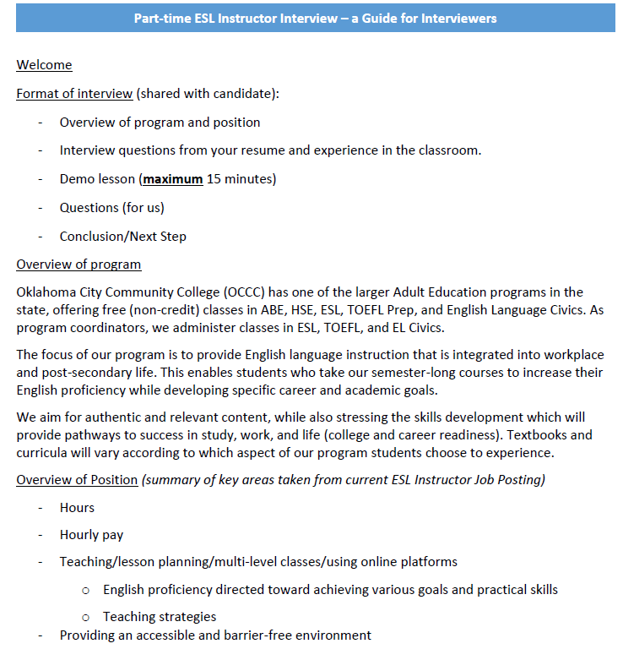
Hiring: The Interview
Interviewer Preparation
  Questions
  Review Resume and Cover letter
The Interviewee’s experience
  Introduce the format of the interview
  Overview of program
  Position-related questions
  Demo Lesson
  Expectations and Questions

Slide 12

Hiring: Post-Interview
Debrief after Interview
Decision to hire (or not)
If hiring, then
Call to Candidate to Offer Position (and location, schedule, etc)
On acceptance,
Initiate Background Check with HR
Advise candidate of process which follows…

Slide 13
Think and Discuss
Think about 1 or 2 things you would like to improve in your program’s Hiring.
Discuss this in pairs or groups of 3.

Slide 14
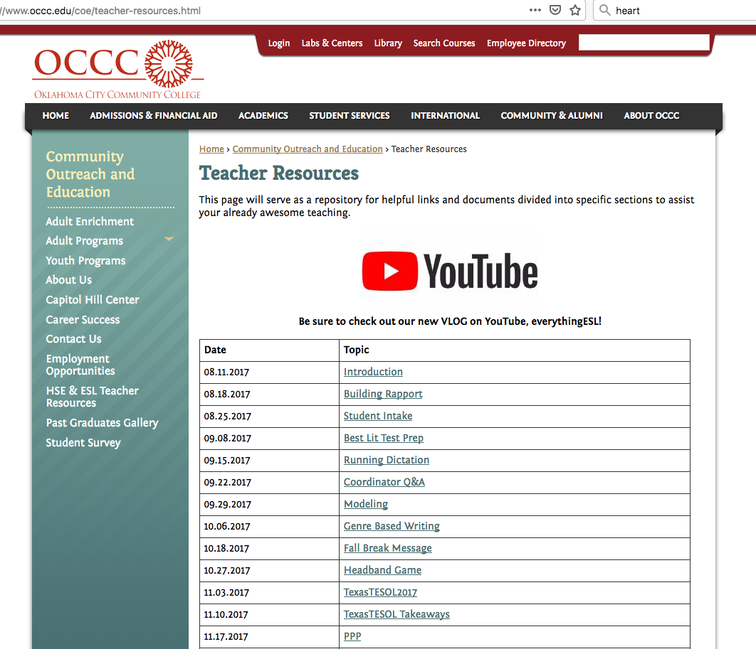
New Hire Training
Phase I : Online Training
  COE ESL Resource page: https://www.occc.edu/coe/teacher-resources.html

Slide 15
New Hire Training
Phase II : Face-to-Face Training
  Policies and Procedures
  Pedagogy - what we value as a program
  Curriculum – by strand – ESL, Citizenship, TOEFL, Burlington English
  Intake process observation

Slide 16
Think and Discuss
Think about 1 or 2 things you would like to improve in your program’s New Hire Training.
Discuss this in pairs or groups of 3.

Slide 17

Professional Development
Plan for your program as a whole
Integrating New Hires into your plan

Slide 18
Professional Development—Our Plan
1-day conference
Informal and Formal Observations
8 week Coaching
In-Service
Vlogs
July
June
October
August
September
November
December
January
May
February
March
April
Notes:
Communication—vlog, email, marco polo, meetings, etc. Different styles to meet the preference of teachers

Slide 19
Integrating a New Teacher
Informal evaluation
New teacher is observed
Observe supervisor’s class
Observe peer teacher’s class
Assimilated into the mainstream PD plan
Develop goals from experience
Mentoring and Feedback session
Mentoring and Feedback session
Meet with peer teacher
3rd month
2nd month
1st month

Slide 20
Think and Discuss
Think about 1 or 2 things you would like to improve in your program’s Professional Development.
Discuss this in pairs or groups of 3.

Slide 21
The Not-So-Perfect Scenarios
The Botched Interview
The Last-Minute Scramble
Left Side of the Room
Right Side of the Room

Slide 22

Questions or Reflections

Slide 23


Thank You!
Eric Beecher
eric.p.beecher@occc.edu
Anthony Tyrrell
atyrrell@occc.edu
Rady Sharkova-Foster
rfoster@occc.edu
www.occc.edu/coe/teacher-resources.html

