Slide 1
Building a Successful Adult ESL Program
Oklahoma City Community College
Department of Community Outreach and Education

Slide 2
About Us
Adult ESL program serves approximately 1000 students each year.
Part of Community Outreach and Education (a department within OCCC).
seek to empower students
provide them with pathways to college, career and life success through a foundation of progress in English proficiency.
Notes:
Oklahoma City Community College (OCCC) serves more than 24,500 students from Oklahoma City and surrounding areas. As a true “community” college, Oklahoma City Community College serves students of all backgrounds and ages.
Community Outreach and Education at Oklahoma City Community College provides short-term, non-credit courses designed to improve basic skills for adults and children.
To provide educational opportunities that empower and inspire individuals to pursue college degrees, certificates, employment and life-long learning. Improved quality of life for individuals through outreach and basic education.

Slide 3
Potential Stages of a Program
Mature
Reinvent
Improve
Growth
Start Up
Notes:
Group Activity

Slide 4
Where is OUR ESL Program?
Currently in the improve/reinvent phase
Determining more specific course objectives and more closely aligning curricula to these objectives
Mature
Reinvent
Improve
Growth
Start Up
Notes:
Group Activity

Slide 5
Where is YOUR ESL Program?
Mature
Reinvent
Improve
Growth
Start Up
Notes:
Group Activity

Slide 6
Where is YOUR ESL Program?
Why do you think your program is at this stage?
What are some of the challenges of this stage?
Mature
Reinvent
Improve
Growth
Start Up
Notes:
Group Activity

Slide 7
The Process
Students
Enrollment
Goal setting
Referrals—networking
Assessment
Teachers
Hiring
Orientation
Professional development
Teacher Evaluation
Course Design
Classes
Instructional materials
Assessment
Creating Objectives
Provide Foundational Skills for Student Success
Develop pathways to College and Career Readiness
Empower students to create positive and measurable change in their lives
Notes:
Evaluation comes under PD
Process defined as a series of actions or steps taken in order to achieve a particular end.

Slide 8
Creating Objectives
Where do these come from?
Why?

Slide 9
Primary Objective
To provide English language training in the context of workplace and post-secondary life, which integrates specific career and academic goals, in alignment with WIOA performance indicators.
Notes:
Goal here is to provide the training-in hope that this will enable students to meet their own personal objectives; hopes and dreams for a better life…and to be the best they can be.
Oklahoma City Community College (OCCC) has one of the larger Adult Education programs in the state, offering free (non-credit) classes in ABE, HSE, ESL, TOEFL Prep, and English Language Civics. As program coordinators, we administer classes in ESL, TOEFL, and EL Civics.
The focus of our program is to provide English language instruction that is integrated into workplace and post-secondary life. This enables students who take our semester-long courses to increase their English proficiency while developing specific career and academic goals.
We aim for authentic and relevant content, while also stressing the skills development which will provide pathways to success in study, work, and life (college and career readiness). Textbooks and curricula will vary according to which aspect of our program students choose to experience.

Slide 10
WIOA and the OCCC ESL Program
Currently developing curricula, pedagogy, processes, and assessment systems to better implement WIOA mandate.
Approach to teaching English both integrated and goal-focused.
Notes:
This means that English proficiency is directed not as an end in itself, but as a means to helping students achieve their personal and professional life goals. Our students, while learning English, will also develop the core academic, workforce, and digital literacy skills they need to be more valuable in the workplace, enter college, or simply be more effective citizens in their own communities.
It is about educating the whole student and making them aware of their full potential. The challenge for our Adult Education program (and specifically ESL) is to find ways to integrate core academic skills with critical employability and life skills.

Slide 11
Course Design
Classes
ESL, TOEFL, and EL Civics
Instructional materials
Project Success, Longman (TOEFL), Voices of Freedom
Assessments
Formative and summative
Notes:
STANDARDIZED Approach
Classes
ESL, TOEFL, and EL Civics
Instructional materials
Project Success
develops creative and critical thinking skills, promotes self-directed learning, and improves student’s ability to communicate in social, educational, and professional situations.
Underlying context provided by career and college scenarios
Ventures (referrals-life skills focus)
Prep/feeder course for our ESL Program (in conjunction with our Literacy Partners who essentially provide this curriculum)
Digital literacy
Goal setting
Assessment
Goal advisor
CASAS
MEL
Team Projects
Portfolio

Slide 12
Teachers
Hiring
Requirements
Interview
Orientation
Policies and Procedures
Curriculum and Pedagogy
Professional development
15 hours per year (mandated)
Coaching and Mentoring
Evaluation

Slide 13
Qualities of a Great Teacher Relative Importance

Slide 15
Teachers
Hiring
Requirements
Interview
Orientation
Policies and Procedures
Curriculum and Pedagogy
Professional Development
15 hours per year (mandated)
Coaching and Mentoring
Evaluation

Slide 16
Students
Enrollment
Pre-assessment
Placement
Goal setting
Goal sheet
O*NET OnLine
OKCareerGuide
Referrals—networking
Tracking students and connecting them with ‘best-fit’ progressive classes
Partner meetings and trainings

Slide 17
Keys to Success
Clear Vision and Objectives
Great Curricula and Highly-qualified Teachers
Alignment of Intake Process with Overall Objective(s)
An Adult-learner approach to Student Success and Assessment
Constant Self-Evaluation at Both Program and Personal Professional Levels.
Notes:
Openness to feedback from team, teachers, and students.

Slide 18
Questions
?

Slide 19
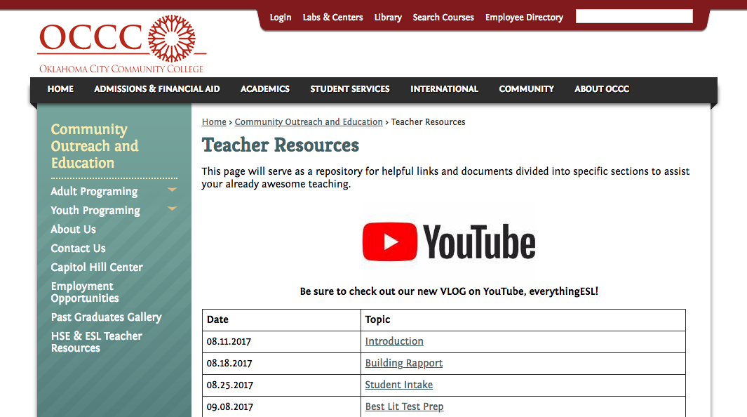
Closing
Anthony Tyrrell
atyrrell@occc.edu
Eric Beecher
eric.p.beecher@occc.edu
Rady Sharkova-Foster
rfoster@occc.edu
www.occc.edu/coe/teacher-resources.html

