Slide 1
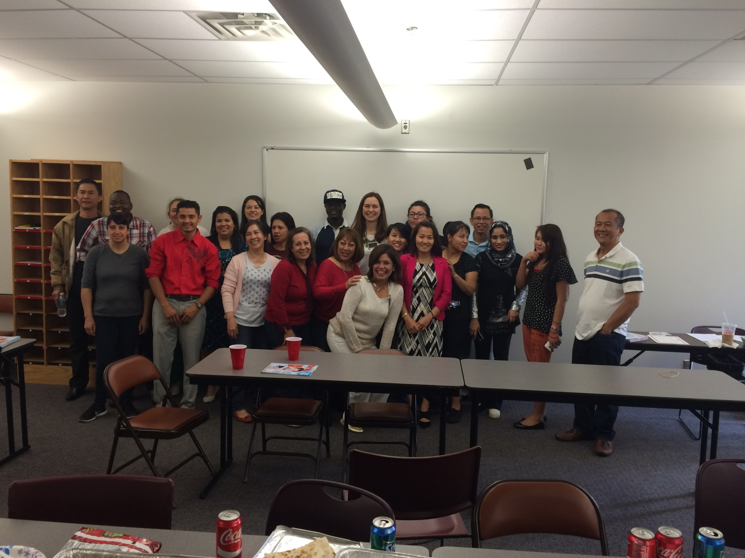
ESL LESSON TECHNIQUES
By Nancy Kintsel

Slide 2
Chain Activities
Simple present with or without adverbs of frequency
Present continuous
Past tense
Future tense
I like to _____
I can ___. I can’t ______.
I have ________. He has ______. She has __.
I’m going on a trip and I’m going to bring a ____.

Slide 3
Please put the candle in the ___.

Slide 4
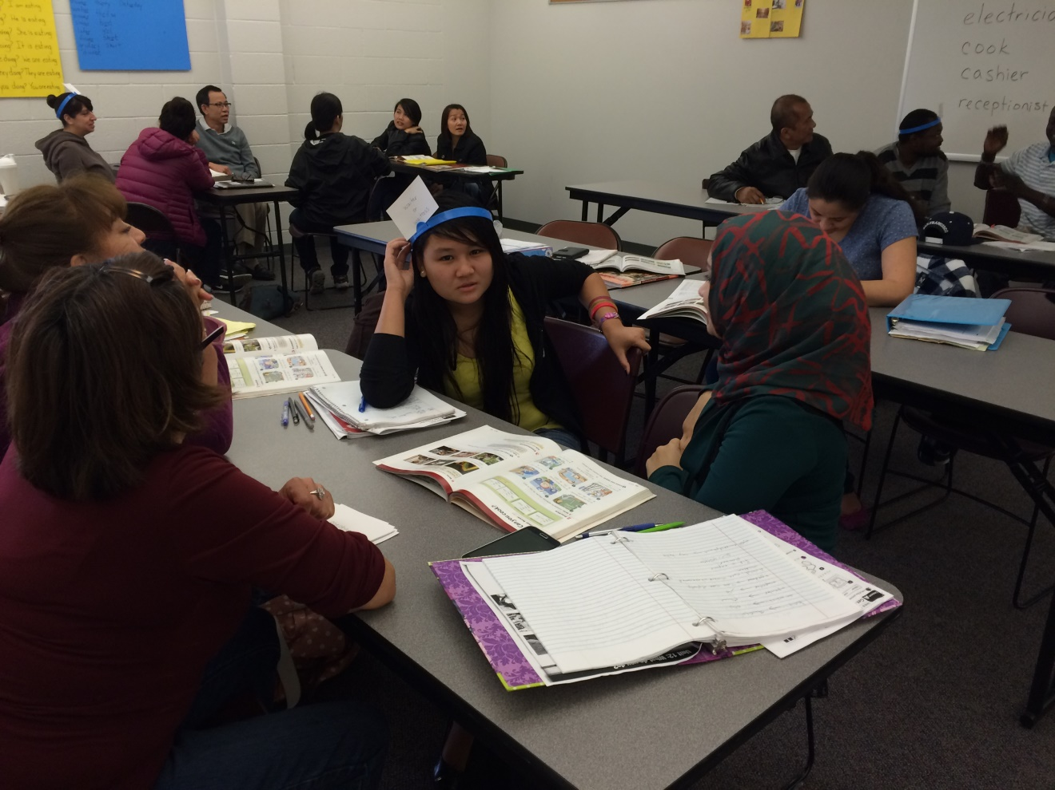
Hedbanz – a guessing game
Scaffolding – how do I help students be successful?

